Slide 1
Complain Box
Component Level Design
Presented to:
Md. Nurul Ahad Tawhid
Presented By:
Atiq Ahammed 0817
Khayrul Islam 0822

Slide 3
Identified classes
User
Admin
Notice
ApplicationForm
Event
Institution
Problem

Slide 4
Class Elaboration

Slide 5
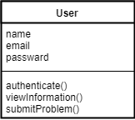
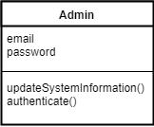
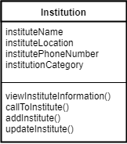
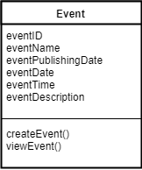
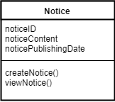
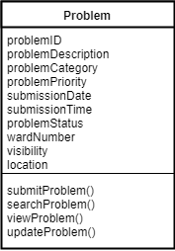
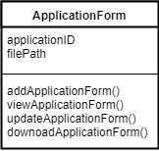
Analysis classes

